Slide 1
MBA532 – AI in Business
MODULE 2 – Defining and Clarifying AI and Machine Learning Concepts

Slide 2
Understanding What Learning Truly Means in AI/ML
Understanding What Learning truly means in AI and Machine Learning Models

Slide 3
Consider three examples of Machine wins over Expert Humans
Example 1: IBM’s Deep Blue computer defeated reigning world chess champion Garry Kasparov in 1996
Example 2: IBM’s AI-based Watson defeated the reigning champion of Jeopardy in 2011
Example 3: AlphaGo AI from Google Deep Mind defeated worldwide Go champion Lee Sedol in 2016.
Implications:
The above pattern of wins illustrates that machines dominate when rules are well defined and known in advance (e.g., a chess or Go game). Machines have a limitless capacity to translate/simulate at scale procedural knowledge into formal knowledge representation rules (often using if-then clauses) to make deductions, or derive new knowledge that inform action. Even human experts are not be able to compete at scale because of memory, cognitive, or other human constraints.
However, business decisions operate in an environment of uncertainty, with no clear rules. So AI’s ability to excel in such an environment has not been tested over a long time horizon, but appears promising and is just beginning to unfold.

Slide 4
Machine Learning (ML) is quite different from typical/traditional Statistics-based models
Statistics emphasizes being correct on average, while machine learning (ML) does not. Instead, the key goal of machine learning is operational effectiveness.
Traditional statistics requires a hypothesis or theory to specify a model with a limited set of variables. ML does not require that; it flexibly accommodates very complex models with a large number of variables. focuses on predictions.
Such prediction-based ML systems “learn” and improve markedly over time. This enables ML to perform tasks that previously depended on human intelligence. However, ML models typically cannot explain the “why” behind their predictions. Only Explainable AI (XAI) models, discussed in Module 7, are capable of addressing that.
(To illustrate this, discuss the 2012 NYT story on Target coupon for baby-care products for a high school student, “How Companies Learn Your Secrets,” https://www.nytimes.com/2012/02/19/magazine/shopping-habits.html)

Slide 5
ML models focus on Prediction
Machine Learning relies heavily on predictions and reinforcement learning.
Predictions resemble the process of filling in missing information. Predictions use information we have (i.e., data) to generate information we do not have (e.g., forecasts).
In addition to generating information about the future, predictions improve our understanding about both the present and the past. Examples: if a current transaction is fraudulent or not; if a tumor in an x-ray image is malignant or not.
Small improvements in prediction accuracy are deceptive. An improvement from 85 percent to 90 percent accuracy appears over twice as large as an improvement from say 98 percent to 99.9 percent accuracy. However, the former may represent the reduction of mistakes by nearly a third, while the latter may reduce mistakes by only 5% of total mistakes, but the latter achievement deserves greater appreciation because it requires an exponentially higher effort, and because it is truly transformational: getting closer to 100% is the holy grail.

Slide 6
Supervised, Unsupervised, Reinforcement, Deep ML
Supervised learning: the goal is to learn a function that, given the data sample and the expected outputs, best describes the links between input and output. E.g. classification, regression or probability estimation.
Unsupervised learning: without any information about the output, the goal is to identify any structures or patterns present in the input data. E.g. cluster analysis.
Reinforcement learning: define the reward function that best helps the AI agent reach its objectives.
Deep learning: Approaches to ML that use Neural Network models with multiple layers.
Fundamental ML include applications include computer vision, speech understanding, autonomous robots, self-driving cars, eVTOLs (electric Vertical Take Off and Landing vehicles), facial recognition, email filtering, optical character recognition, product recommendations, identifying cancerous tumors,
detecting data breaches, vetting hires etc.

Slide 7
Supervised learning – more highlights
What is Supervised Learning?
In summary, supervised learning applies machine learning training algorithms to labeled data; where each case in the training data has both observation and outcome data.
After the ML system has “learned” these categorization and variable relationships, it can be assigned to work with new data where the outcome will be known in the future, so the machine is now required to make a prediction about the future. The training algorithms can predict those future outcomes based on the previous supervised learning.

Slide 8
Unsupervised learning – more highlights
What is Unsupervised Learning?
For certain types of activity where there is not a database available that contains labelled data for the algorithm to use, a different set of techniques called unsupervised learning can be applied. This approach identifies and groups things together based on similarities between them (e.g., clustering), but they do not provide predictions that indicate how someone or something is going to behave. The objectives and outputs of supervised and unsupervised learning are therefore very different.
With supervised learning, the end game is always a prediction that could be used in decision making. With unsupervised learning, the outcome is a representation of the structure of the data which is a different thing altogether.

Slide 9
Reinforcement Learning – more highlights
Reinforcement learning is an approach in machine learning based on “rewards” and “punishments or penalties” designed by developers to steer the machine into desirable behavior. Algorithms learn as desired by developers through trial and error.
A notorious application of reinforcement learning is AlphaGo created by Google DeepMind, which was trained to play Go at a world-class level.

Slide 10
Deep Reinforcement Learning Agents
Google DeepMind created an artificial intelligence program using deep reinforcement learning that can start with Atari games and improve itself to a superhuman level. It is capable of playing and learning from many Atari games by using a combination of deep artificial neural networks and reinforcement learning.
This AI system initially knew nothing about this game – or about any other games, or even about concepts such as games, paddles, bricks or balls. The AI was simply told to maximize the score of outcomes.
https://tinyurl.com/atariai

Slide 11
What is the Turing Test?
A Turing Test is a method of inquiry in artificial intelligence (AI) to determine whether or not a computer is capable of thinking like a human being.
ChatGPT has recently passed the Turing Test.
The test is named after Alan Turing, who first suggested this as a Test concept. Turing was a well-known UK-based computer scientist, crypto-analyst, mathematician and theoretical biologist.

Slide 12
Computational Creativity and AI?
Computational Creativity (CC) as a final frontier for AI….
As a society, we are jealous of our creativity. Creative people and their contributions to cultural progression are highly valued. Moreover, creative behavior in people draws on a full set of intelligent abilities, so simulating such behavior represents a serious technical challenge for Artificial Intelligence research. As such, we believe it is fair to characterize Computational Creativity as a frontier for AI research beyond all others – maybe, even, the final frontier. - Simon Colton and Geraint Wiggins
AI-based CC can formulate tasty recipes, new visual art, creative poetry and stories, jokes, mathematical theorems, games, or chess puzzles. In short, using computational or artificial means, a computer can generate designs that, if any human produced them, would be deemed as creative art.
(Question to Ponder: Does this mean CC passes the Turing Test?)

Slide 13
Neocognition
Deep learning is based on two fundamental ideas: hierarchical pattern recognition and learning.
Neuroscientists David Hubel and Torsten Wiesel won the 1981 Nobel Prize in Physiology or Medicine. Hubel and Wiesel discovered that different neurons in the visual system responded to visual stimuli in sharply different ways. Some responded more actively to very simple stimuli while others responded more vigorously to more complex stimuli.
In the 1980s, Japanese neural network pioneer Kunahiko Fukushima built an actual computational adaptation of Hubel and Wiesel’s idea, that was labeled Neocognition.
Neocognition was made up of a set of layers, which set the stage for the development of ANNs (Artificial Neural Networks).

Slide 14
What does Learning mean for Machines?
For any physical matter (like a machine) to master learning, the machine must be configured to get better and better at reaching the desired goal of learning – simply by obeying the laws of physics.
The human brain’s network of interconnected neurons learns in an analogous way: if the brain is repeatedly subjected into certain states (or experiences), it will gradually learn those states and return to them from any nearby state.
For example, if you’ve seen each of your family members many times, then memories of what they look like can be triggered by anything related to them (such as a phone call or a written message from them).
A similar learning function could be inferred by machines, by deploying a system widely known as Artificial Neural Networks (ANNs).

Slide 15
GPUs as principal contributor to the widespread use of Artificial Neural Networks (ANNs)
In some ways, the most important advance came not from some technical breakthrough in neural networks – that evolved in the 1980s – but from a special piece of hardware known as a GPU (Graphics Processing Unit).
GPUs had originally been developed for video games since the 1970s, and applied to neural network applications since the early 2000s.
Key to this newfound success was the fact that GPUs allowed researchers to “train” neural networks that were much deeper (having more layers) than was previously feasible
Leveraging GPUs meant that more layers could be trained faster, with much better results.
By 2012 GPUs had become extremely powerful, and were generally more efficient than CPUs in computers. At this time, GPUs, and other chips that also function in parallel processing mode (such as Intelligence Processing Units or IPUs pioneered by GRAPHCORE) and Neural Processing Units (NPUs) are used extensively in AI applications.

Slide 16
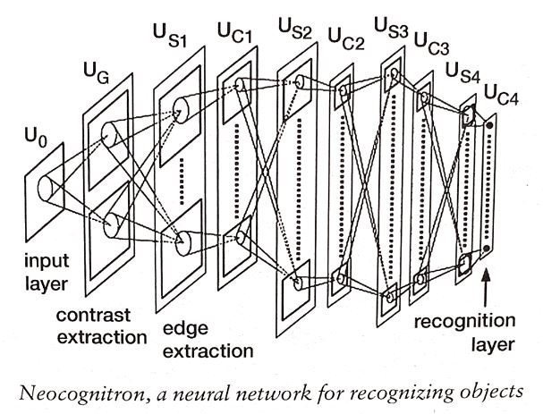
Layered Elements of Artificial Neural Networks (ANNs)
Going from left to right in the diagram, there is first an input layer that is presented with a stimulus e.g., the pixels in a digital image; then subsequent layers analyze the image, looking for variations in contrast, edges, and so forth, ultimately culminating in an output layer that identifies what category the input image belongs to.
Systems like these are called neural networks, because each layer consists of elements called nodes that can be likened to simplified neurons.
There are connections between those nodes, also called connection weights, or just weights. The larger the weight on the connection from node A to node B, the greater the influence of A on B.

Slide 17
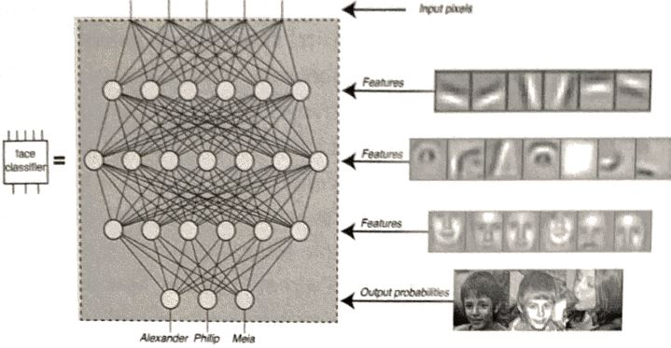
How do Artificial Neural Networks (ANNs) Work?
Artificial Neural networks (ANNs) dominate the ML domain.
The ANNs have been trained to input numbers representing the brightness of different image pixels and output numbers representing the probability that the image depicts various people.
Each artificial neuron (circle) computes a weighted sum of the numbers sent to it via connections (lines) from above, applies a simple function and passes the result downward, each subsequent layer computing higher-level features.
Typical face-recognition networks contain hundreds of thousands of neurons. The figure above shows a small number for clarity.

Slide 18
Types of NNs (a quick tour)
Using Artificial Neural Networks (ANNs) and other methods, researchers have produced beautiful music or paintings in the style of well-known (but deceased) artists.
Feedforward Neural Networks (FNNs) are the simplest where information moves only in the forward direction from the input layer through the hidden layers (between input and output) to the output layer. There are no loops in this network.
Recurrent Neural Networks (RNNs) are characterized by connections between neurons that include loops. A good example is Long Short Term Memory networks (LSTMs) with feedback connectors that are used in language processing tasks.
Convolutional neural networks (CNNs) were invented as a superior neural network model for handling input data consisting of images.
Generative Adversarial Networks (GANs) may employ competing ANNs to produce photorealistic images of faces. GANs use two neural networks that compete against each other: one network is trained to detect fakes, and the other is trying to fool the first one.

Slide 19
Convolutional Neural Networks (ConvNets)
ConvNets are the driving force behind today’s deep-learning revolution in computer vision and other applications.
Like neocognition, the design of ConvNets draws on key insights about the human brain’s visual systems.
A ConvNet consists of a sequence of layers of simulated neurons called units. Units in each layer provide input to units in the next layer. Analogous to how neural networks function, when a ConvNet processes an image, each unit takes on a particular activation value – a real number that is computed from the unit’s inputs and their weights. E.g. Google’s “Search by images” operates this way.
Notes:
Artificial Intelligence-A Guide For Thinking Humans

Slide 20
Applications of ConvNet to computer vision
ImageNet and other data sources provide ConvNet vast amounts of training examples needed to improve AI applications, allowing firms to apply computer vision in new ways:
Google offered a photo-storage system that tags photos by describing the objects in it; similarly, Google’s Street View service recognizes and blurs out street addresses and license plates in its images.
Facebook labels all uploaded photos with names of users’ friends; it has also patented a system to classify emotions behind facial expressions in uploaded photos.
Twitter (X) developed a filter that screens tweets for pornographic images; and several photo- and video-sharing sites apply tools that detect imagery associated with terrorist groups.
ConvNets can be applied to video and used in self-driving cars to track pedestrians, to read lips or to classify body language.
ConvNets can even diagnose breast and skin cancer from medical images, determine from images the stage of diabetic retinopathy, or prostate cancer.
Notes:
Artificial Intelligence-A Guide For Thinking Humans

Slide 21
Caveat on ConvNets
Have ConvNets Surpassed Humans at Object Recognition? Machines are now better than humans at object recognition on ImageNet, since humans have an error rate of about 5%; error rate for machines is close to 2%.
Question to ponder: Convnet’s response could be falsely derived even if it is correct:
When a human correctly says that a photo contains a dog, it is safe to assume that the human actually saw a dog there. But if a ConvNet correctly identifies a “dog” in a photo, maybe it is because there is something else there that it recognized (such as a dog leash) that was associated with dogs in the images on which it was trained, so it uses that learned association to falsely infer that there is a dog in the photo.
Bottomline:
Given the current state of AI evolution, we can never be sure that an AI system is actually as intelligent as it “appears” to be from its performance. So the word “artificial” in AI acquires new meaning here, because what if the AI pretends or appears to understand as humans do, but in fact does not?
Notes:
Artificial Intelligence-A Guide For Thinking Humans

